Slide 1
Analytics using SQL Data driven analytics project
Mentor: Munna Pandey
submitted by: S. Pratheek
Wave number:4777
Batch Number:da374S37

Slide 2
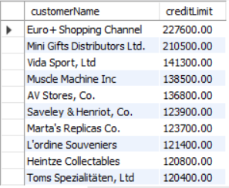
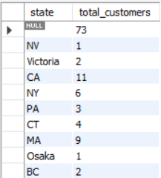
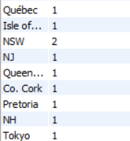
Sprint-9:Customer Data Analysis
Find top10 customers from credit limit Output:
select customerName,creditLimit from customers
order by 2 desc
limit 10;
Interpretation:
In this task we have identified top 10
Customers
Find average credit limit of customers in each country
select state,avg(creditLimit) as avg_creditlimit from customers
group by state; Output:
Interpretation:
In this task we have identified
Country wise average credit limit of
customers

Slide 3
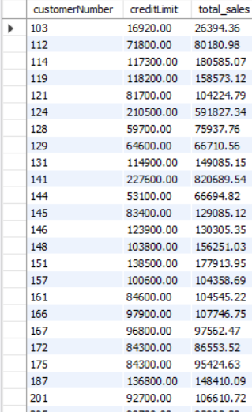
.
Identify customers who have exceed there credit limit
select customerNumber,creditLimit,sum(quantityOrdered*priceEach) as total_sales from customers Output:
join orders using(customerNumber)
join orderdetails using(orderNumber)
group by customerNumber
having sum(orderdetails.quantityOrdered*priceEach) >
creditLimit ;
Interpretation:
In this task we have identified customers
Who have exceeded there creditmint.

Slide 4
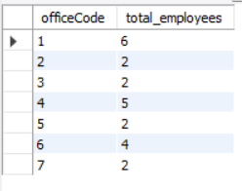
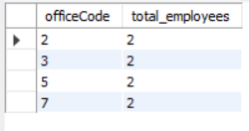
Office Data Analysis
Count no of employees working in each office Output:
select officeCode,count(employeeNumber)
as total_employees from employees group by 1;
Interpretation:
In this task we have found count of employees
In each office
Identify the offices less than certain number of employees
select officeCode,count(employeeNumber) as total_employees from employeesgroup by 1having total_employees < 3; Output:
Interpretation :
In this task we have identified offices with employees
less than 3

Slide 5

.
Retrieve most profitable office based on sales
select employees.officeCode,
sum(orderdetails.quantityOrdered*priceEach) as totalsales
from employees joincustomers on employees.employeeNumber = customers.salesRepEmployeeNumber
join orderson customers.customerNumber = orders.customerNumber
join orderdetails on orders.orderNumber =
orderdetails.orderNumber Output:
group by employees.officeCode
order by totalsales desc
limit 1;
Interpretation:
In this task we have identified most profitable
Employee based on sales by joining different tables

Slide 6
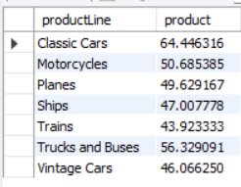

Product Data Analysis
Find productLine with highest average product price
select productLine,avg(buyPrice) as product from products Output:
group by 1;
Interpretation:
In this task we have identified hightest average price of
productline.
Retrieve most expensive product based on MSRP
select productName,MSRP from productswhere MSRP in(select max(MSRP) from products); Output:
Interpretation:
In this task we have identified the expensive
product based on MSRP

Slide 7

.
Identify the top selling products based on quantity ordered using stored procedure the procedure should accept input parameter
delimiter //
create procedure sp_topselling_product(in Code varchar(50),out state varchar(50))
Begin
declare cn int;
select sum(quantityOrdered) into cn from orderdetails where productCode =Code;
if cn > 1060 then Output:
set state = 'topselling product’;
else
set state = 'not topselling product’; Interpretation:
end if In this task we have createdstoredprocedure
End which accept code as input and tells is it
// topselling or not
delimiter ;
call sp_topselling_product('S12_4675',@state);
select @state;

Slide 8

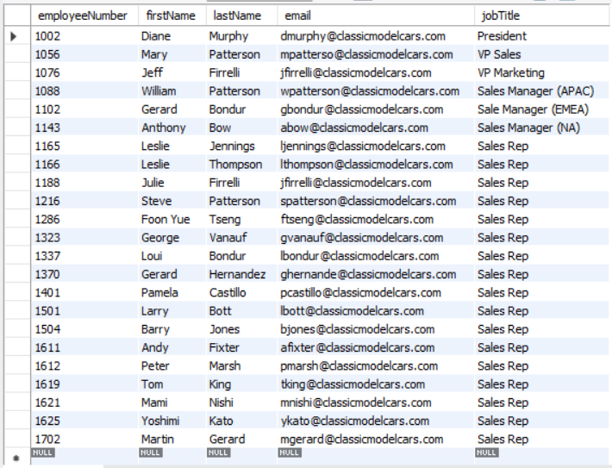
Sprint 10 Employee Data Analysis
Find all total number of employees
select count(employeeNumber) as total_employees from employees;
Interpretation:
In this task we have found the total employee count
Output:
List all employees with basic information Output:
select employeeNumber,firstName,lastName,
email,jobTitle from employees;
Interpretation:
In this task we found employees basic
information

Slide 9


.
Count number of employees holding job title
select count(employeeNumber) as total_employees from employees where jobTitle is not NULL;
Interpretation:
In this task we found count of employees with job title
Output:
Find all employees who don't have manager
select employeeNumber,firstName from employees where reportsTo is NULL;
Interpretation:
In this task we found employee not assigned to manager
Output:

Slide 10
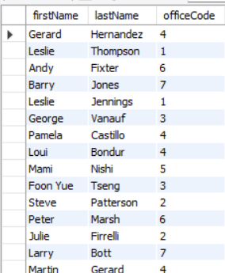
.
Find all the names of employees who have sold more than average sales amount for their office
select firstName,lastName,officeCodefrom employees join offices using(officeCode) joincustomers on employees.employeeNumber = customers.salesRepEmployeeNumber join orderson customers.customerNumber = orders.customerNumber join orderdetails on orders.orderNumber = orderdetails.orderNumber
group by firstName,lastName,officecode
having sum(orderdetails.quantityOrdered*priceEach) > (select avg(orderdetails.quantityOrdered*priceEach)from orderdetails Output:
join orders on orders.orderNumber = orderdetails.orderNumber
join customers on customers.customerNumber =
orders.customerNumber
join employees on employees.employeeNumber = customers.salesRepEmployeeNumber);
Interpretation
In this task we identified employees who
sold more than average sales amount for their office

Slide 11
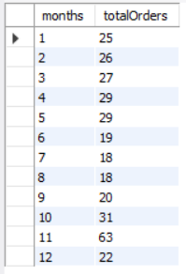
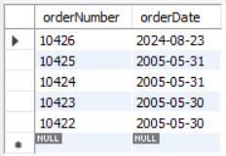
Order Analysis
Find number of orders placed each month
select month(orderDate) as months,count(orderNumber) as totalOrders from ordersgroup by 1; Output:
Interpretation:
In this task I have identified orders
placed each month
Retrieve most recent orders based on orderdate
select orderNumber,orderDate from orders
order by orderDate desc Output:
limit 5;
Interpretation:
In this task we have retrieve most
Recent orders

Slide 12
.
Create a trigger that automatically updates a customers credit limit after a new order is placed, reducing it total order
delimiter //
create trigger updateCreditlimitafter
insert on orders
for each row
Begin
declare cost int;
Insertintoorderdetails(orderNumber,productCode,quantityOrdered,priceEach,orderLineNumber) values(new.orderNumber,'S18_1749',30,136,2);
update products set quantityInStock = quantityInStock - 30 where productCode = 'S18_1749’;
select sum(orderdetails.quantityOrdered*priceEach) into cost from orders join orderdetails using(orderNumber)where orderNumber = new.orderNumber;
update customers set creditLimit = creditLimit - cost where customerNumber = new.customerNumber;
End
//
delimiter ;
insert into orders(orderNumber,orderDate,requiredDate,shippedDate,status,comments,customerNumber) values(10426,curdate(),adddate(curdate(), interval +7 day),adddate(curdate(), interval +4 day),'Shipped','null',103);

Slide 13
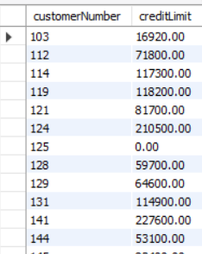
.
Output:
Interpretation:
In this task by using trigger we have update the credit limit of customerNumber
103

Slide 14
Summary
Sprint9
In this sprint we have analyzed customer ,office,products
In customer we have analyzed top 10 creditlimt customers and country wise average credit limit and customers exceed credit limit
In offices we have analyzed count of employee in each office and most profitable office based on sales
In products we have analyzed highest average price of productline,expensive product based on MSRP ,created storepocedure which tells where product is top selling or not top selling
Sprint 10
In this sprint we have analyzed employee,orders
In employees we have analyzed total employee,there information ,employee with no manager assigned and employees who sold morethan averagesales amount of their office
In orders we have analyzed no of orders each month , most recent orders based on order date
In orders we have create triggers to update the credit limit as order is palced completely

Slide 15
Conclusion
The analysis of sprint 9offers a view of customer,office and products. Its identified top customers by creditlimit,average creditlimit and customers who exceeded the limit and it evaluates the office performance number of employees and most profitable office .In product it analysis product which are top selling and which are not topselling .This analysis can be used for decision making in customers ,products and offices as it provides the key insights of respective table analysis
The analysis of sprint10 offers a view of employee and orders .Its identified the total employees ,shows employees with job titles and employees with np manager additionally calculates the total sales of each product and adjust the creditlimit of customers based on orders placed also highlight order amount foe each customer. Identified products which are not shipped and delayed products. This analysis help to decision because it highlight the insights and relations between tables

